Slide 1
5 Core Metrics to Guide Your Software Endgames
Software Test & Performance Conference: April 17-19, 2007
Bob Galen
RGalen Consulting Group, LLC
www.rgalen.com bob@rgalen.com
Notes:
Overview:
By its very nature, the Endgame of software projects is a hostile environment. Typical dynamics include tremendous release pressure, continuous bug & requirement discovery, exhausted development teams, frenzied project managers and “crunch mode” – a PC term for overtime.
Testing teams are usually in the thick of this battle and accustomed to these dynamics. However, I don’t think we do enough to help guide the projects focus and attention in the Endgame. Yes, we work hard and report bugs, but we can do so much more to influence and focus a projects direction.
In this presentation, you’ll learn how testers can focus the entire team on a few key performance metrics to improve the overall endgame experience and increase the probability of delivering on-time. And yes, to also survive yet another Endgame.
Learning Objectives:
How to provide effective traffic direction for the incoming defect “stream”
Why keywords are a great way to focus project releases
Highlighting defect repair performance characteristics without alienating development
How to provide powerful Pareto guidance into project risk areas
Why developing a set of Metrics Analysis Questions (MAQ’s) can help your analysis.
In v2 I added:
The 2-hump chart
True Pareto chart
And made cosmetic changes to many of the slides, particularly the metrics focused slides

Slide 2
Outline
Notion of QA teams as GUIDES not reporters
Metrics Analysis Question (MAQ) development
5 Key Metrics
  Found vs. Fixed
  High Priority
  Project Keywords
  Defect Transition Progress
  Product Functional Area Distribution
  with MAQ, Guide Points and PM Guidance
Wrap-up and Q&A

Slide 3
Introduction
We (Testers) need to adjust from a
  Detecting
  Reporting
  “Safety net” or “Gating” perspective or role
To one including all of the above, but more so serving as a project Guide. Providing more -
  Deep data insights and recommendations
  Bottleneck and efficiency improvement guidance
  Risk detection and resource application guidance

Slide 4
Metrics Analysis Questions
Origin
STQE May/June 2001 article by Anna Allison – Meaningful Metrics
Looking for the meaning behind the metrics or project data
Determining a list of questions to ask when viewing or observing project data trends
Can simply ask. Increase your curiosity and give yourself a license to inquire.
Always looking to provide higher level guidance to the project team
Notes:
Anna was unfortunately killed on one of the Boston 9/11 flights. Her ideas around MAQ’s are quite simple, yet powerful.

Slide 5
Metrics Analysis Questions
Examples
Has there been a change in QA personnel assignments that could account for fewer bugs being found in the last cycle?
  Vacations, time-off, illness?
  Another project starting up?
We’ve seen a drastic increase in priority 1 defects in this last release. Did the developers do something?
  Add a new component, fix some related defects?
  Are we testing something for the first time?

Slide 6
Metrics Analysis Questions
Examples – cont.
What kinds of bugs are being found?
  Severity mix? Priority mix?
  What is the trending? Did we expect this?
  Are these only code bugs or other things? Relationships in counts and trending?
Is the software really stabilizing / maturing?
  Where specifically – everywhere? Exceptions?
  Same trends? Anything troubling or getting worse?

Slide 7
Metrics Analysis Questions
Why?
Why ask? Why probe?
  Provide insight for improved management decision-making
  Alert team to risks
  Provide clarity and insight into the REAL state of the product & project
  Because you have the ability to do so AND the functional breadth to do it well
Notes:
I think there’s a natural tendency for engineers (and testers) to simply sit back and report on progress of a project. It take another level of initiative and confidence to actually step out, question and interpret the data. It means becoming visible and taking a risk – of being wrong.

Slide 8
5 Core Metrics to Guide Testing in Your Endgames
Found vs. Fixed
High Priority
Project Keywords
Defect Transition Progress
Product Functional Area Distribution
Notes:
Perhaps define what I mean by metrics. In this case, its more wrapped around:
Monitoring your DTS workflow and what’s contained in your defects. In my case, they’re potentially overloaded with: features, enhancements, regressions, and true defects
Adding fields for further analysis
Asking questions around what you observe

Slide 9
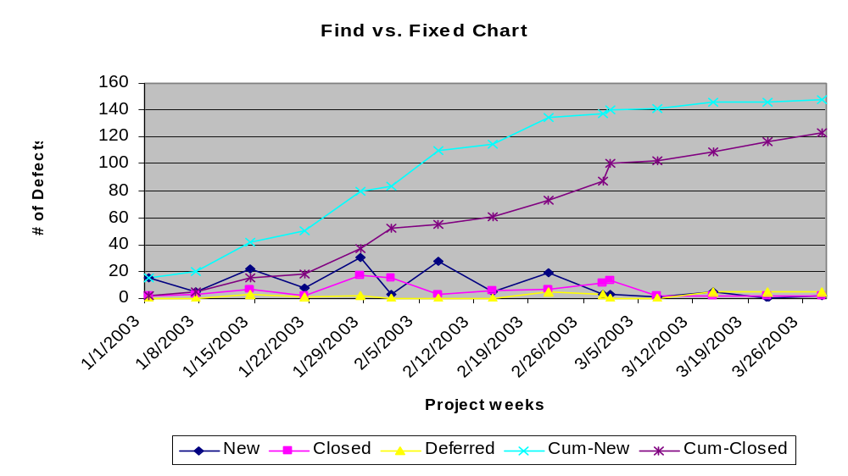
Defects Found vs. Fixed
Trending - Maturation
Notes:
Or Incoming vs. Closed. Trending view here is – how is the software maturing? Comparing new vs. closed on a week by week basis. Are new defects declining and what is the cumulative view? When the cumulative trends intersect, you have reached an equilibrium point for the release.
Keep in mind

Slide 10
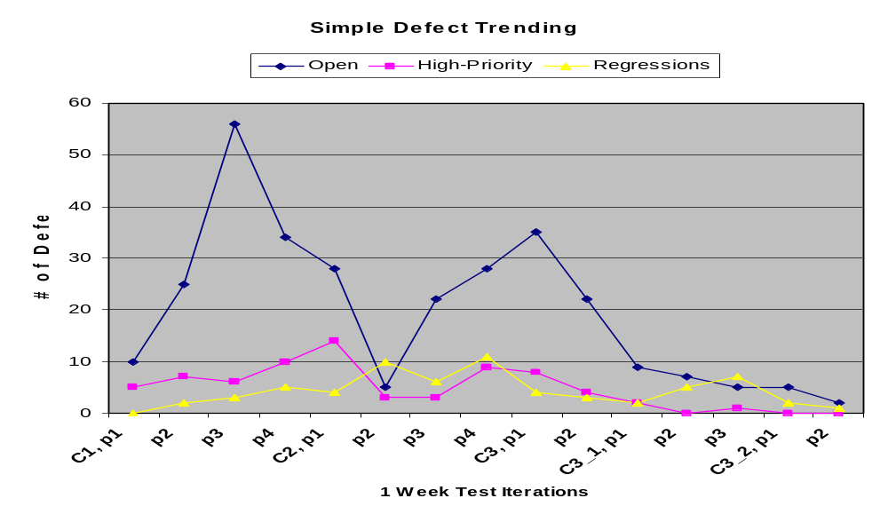
Defects Found vs. Fixed
Trending - Maturation
Notes:
This is a different view towards maturation. Here we’re tracking total open, high priority, and regressions (either failed enhancements or repairs) over testing release cycles.
I’m also trying to reflect the global stabilization pattern for the organization. In this case, you see the “two hump” model for open defects. There can be several drivers for this:
Code freeze then stabilization
Other iterative deployment activity
Test team testing strategy (coverage) relating to iterations
A key point is that these Meta patterns often repeat for all projects within an organization / project mix!

Slide 11
Defects Found vs. Fixed
Trending - Maturation
Found – new, vs. Fixed – repaired, closed, duplicate, not-a-bug, works-as-designed, etc.
MAQ
  What are the general trends? Found down? Fix up?
  Is the trending stabilizing for the project or test cycle?
  Are we approaching a release point? (cumulative trends intersect, with period of low / no find and stability)

Slide 12
Defects Found vs. Fixed
Trending - Maturation
Key Guide Points
  Carefully view trending to take into consideration organizational or other anomalies
  Looking for equilibrium or regression trends (progress & stability vs. backsliding)
Feedback to Project Management
  Release readiness predictions
  Triage / closure concerns
  Intermittent trend influences – identifying root causes
Notes:
You should also observe the cumulative trends for convergence. This will indicate stabilization of the project and the potential point for a release. Teams usually have a historical rule-of-thumb for when convergence is indicating stability and a release point. Normally, it’s along the lines of achieving convergence and then a consistently low and flat arrival vs. repair rate for 2-3 weeks. In conjunction with no new high priority defects.

Slide 13
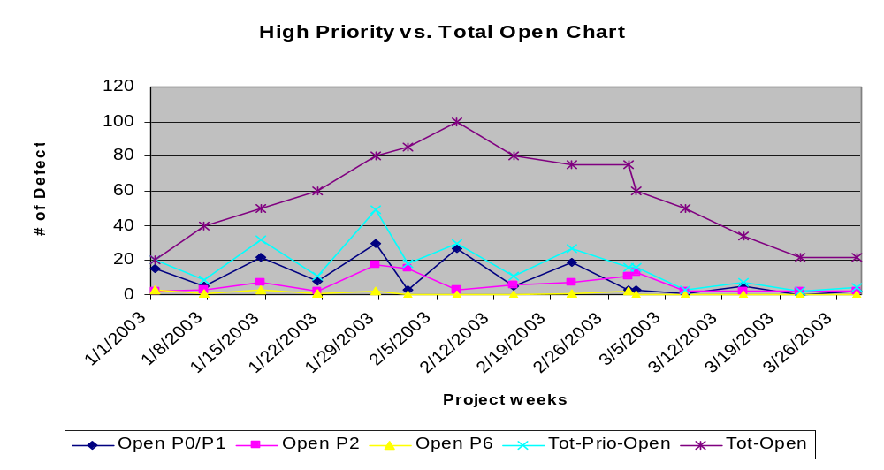
High Priority
Trending – Robustness & Risk

Slide 14
High Priority
Trending – Robustness & Risk
Specifically defined set of defects indicating high priority (defects vs. enhancements) monitored as a significant group
MAQ
  What is the overall trending – relative to position within the Endgame release cycle?
  Stable downward curve? Is there any spiking or obvious trend regression?
  Defects vs. Enhancements – scope creep?

Slide 15
High Priority
Trending – Robustness & Risk
Key Guide Points
  High priority defects should decline and stabilize early in testing iterations
  Continuous and abrupt downward trending
  Shouldn’t occur midway to late in Endgame
Feedback to PM
  Any “spiking” in trending usually indicates a systemic regression of some sort
  Late in the Endgame implies lack of robustness and increasing risk
Notes:
You should expect high priority and high severity defects to decline over the endgame release cycle. There are no clear rules-of-thumb here, other than a consistent downward trend over time that matches the improving stability of the product. I’ve often used an end cycle heuristic that says I should not be seeing (n) level of defects when I approach (n) weeks from product release. I use historical data to derive this “stability gate” and inject it into my plans. It gives me an early indication of the product maturity level. In general, don’t get too enthusiastic with brief downward or “positive” trending. These can be driven by actual positive events within the project or anomalies that aren’t related to progress. For example, the testing team could have been out on a weeklong training class that impacts a testing cycle. If you viewed this from a defect perspective, you would see a sharp downturn in incoming New vs. Closed defects and then an abrupt increase when they returned to full steam after the class. This would also show in Open / high priority increases as well. All of this intermittent and short duration activity is quite normal and should not cause over or under reaction. What really helps is to compare trends to prior project data, so you can gain further insight into typical development team trends. This will help you in contrasting current trends against historically equivalent trending. While there are no guarantees, I’ve usually noticed remarkable similarities within the same teams and product development efforts.

Slide 16
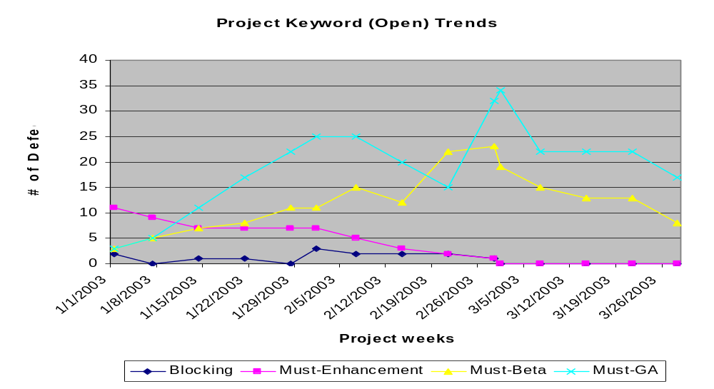
Project Keywords
Trending – PM Workflow Impact

Slide 17
Project Keywords
Trending – PM Workflow Impact
Attaching keywords to defects, allowing for targeting repairs towards your iterative release planning scheme. Normally driven by triage and change control.
MAQ
  What is the trending of “must have” repairs for individual project milestones?
  What are the priorities within each targeted milestone release?
  Will we make it? And what needs to be deferred?
Notes:
Keyword examples:
Blocking: Any defect that is blocking progress within the project. Typically this is testing progress, but it can also impact development, documentation and even the customer. This usually has a bottom line effect on the overall schedule and needs to be addressed immediately. Typically, blocking types of problems are good candidates for workarounds.
Must–Enhancement: This enhancement is required for final release of the product.
Must–Beta: This defect has been triaged and determined to be required for Beta test entry.
Must–GA: This defect has been triaged and determined to be required for General Availability (GA) of the product.

Slide 18
Project Keywords
Trending – PM Workflow Impact
Key Guide Points
  Define meaningful keywords aligned with major project milestones
  Target features, enhancements, and repairs towards these milestones
Feedback to PM
  Blocking issues
  Trending relative to milestones, example Code Freeze
  Deferral guidance (priority, impact)
Notes:
It’s a good idea to correlate the average productivity of your development group to the overall numbers of open issues on delivery milestone targets to see if you will indeed hit the target at your current trending rates. This makes the assumption that the trends and the fix rates will continue, perhaps a bit of a stretch, but at least it gives you a predictor to monitor. You should also factor in a “settling period” of at least a week or two when the trending flattens out – to allow for some schedule buffer and more importantly for some final testing time.
This chart also gives you good insight into enhancement additions. Again, late in the game enhancements should be a concern and monitored for appropriate priority and necessity. You can also draw a linkage between changes driven towards a set of enhancements and the overall project defect trends. Oft-times, enhancements or large sets of new functionality can introduce overall product instability – increasing your project risk and introducing significant churn.

Slide 19
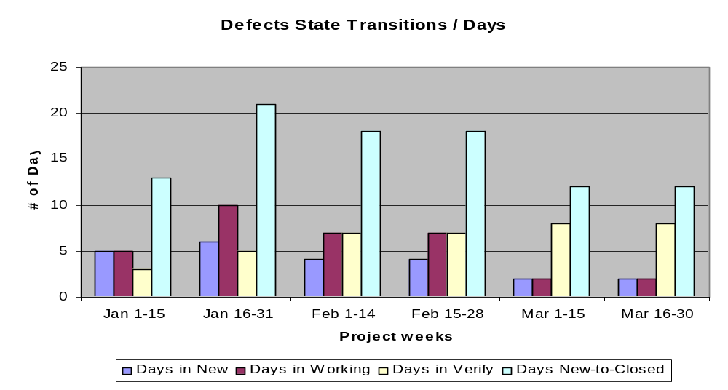
Defect State Transitions
Trending – Development Capacity

Slide 20
Defect State Transitions
Trending – Development Capacity
Reviewing defect activity state transitions to determine team capacity (efficiency & capacity)
MAQ
  What is the typical triage / assigning time (Triage)?
  What is the typical repair turnaround time (Dev)?
  What is the typical verification time (Test)?
  What are the trending and relationships amongst the team workflows? Improving or not? Performance problems – specific bottlenecks?
Notes:
Time spent in the New state, indicative of triage and repair assignment turnaround time.
Time spent in the Working state, indicative of actual development repair time.
Time spent in the Verify state, indicative of test verification time.

Slide 21
Defect State Transitions
Trending – Development Capacity
Key Guide Points
  As the project progresses, triage should reduce from 5-7 days average to < day average
  Development time should decrease as they move from construction iterations to repair, polish & maintenance
  Verification time relates to overall testing cycle time, early feedback preferred.
    Regression rates come into play
  # of days moving from New -> Closed indicates overall team capacity
    Should be factored into iteration release plans.
Notes:
There are two other drivers for minimizing the amount of testing or Verify time across your project. First, you will certainly get a number of regressions from your repairs. In my experience this is roughly 5-15% of the total repairs. It is imperative that you detect these as early as possible, get them re-triaged, assigned and back into the Working state. The second part of this is at the program level. The quicker you can resolve and Close defects, the faster you reduce the defect set that you are managing. It’s a forest and trees problem. You should ‘migrate’ defects to Close as quickly as possible so you can see the challenges accurately. This chart indicates how effectively this is occurring.

Slide 22
Defect State Transitions
Trending – Development Capacity
Feedback to PM
  Triage backlog & workflow bottlenecks – tracking average time to New -> Close
  Filter out anomalies
  Development-to-testing equilibrium
    Either function overloaded, suggest adjustments. More developers, more testers, help each other, adjust goals.
  Factor functional and team capabilities into iterative release planning.

Slide 23
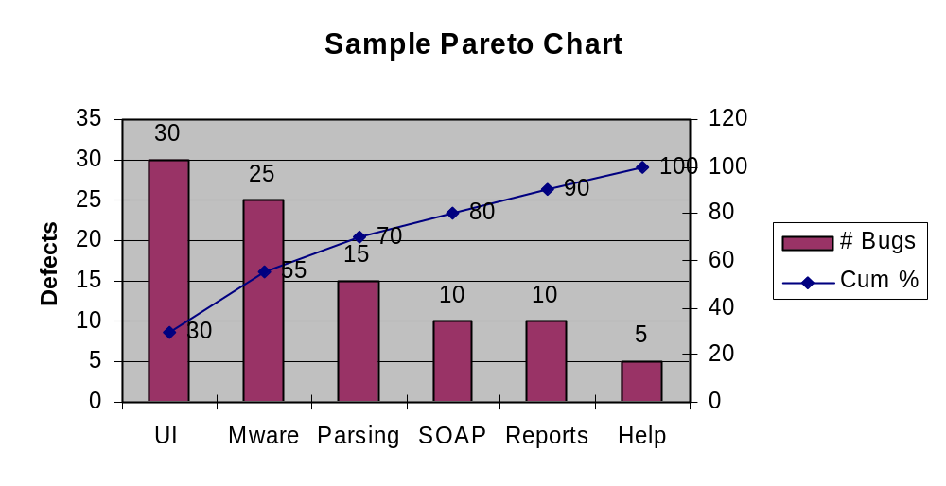
Open Defects per Functional Area
Trending – Pareto (80:20 Rule) Guidance
Notes:
Pareto analysis, otherwise known as the 80:20 rule, is very useful when analyzing defects at a component level. The rule states and I’m paraphrasing here, that 80% of the defects will be focused in 20% of the functionality. In this case, you chart the defects from a cumulative or total application perspective and then bar chart them in descending order by component. You should always notice the Pareto skew defects (the 80%) towards just a few components or parts (the 20%) of your system
Why is this useful? At a high level it defines a clustering tendency in most systems, including software systems. The phenomena can be leveraged several ways. From a test perspective, it can serve as a “guide” to where you should be spending more of your time in testing. It can even influence the style of your testing, to more of an exploratory style in higher defect density components.
From a management perspective, it can help you to isolate risk towards specific components or product areas. This can guide your reactions to resources assignments, applied processes and risk management strategies. You can also use this information as you deploy the product to the customer for early usage and Beta testing.
This is a very useful technique to apply early on in your endgame, as it will help you in making adjustments at a more informed and granular level throughout. If you’re interested in further research on Pareto analysis, and I hope you are, I would recommend a web search to find sources and tools supporting Pareto charting and analysis. It’s also a Six Sigma tool, so you’ll turn up references there too.

Slide 24
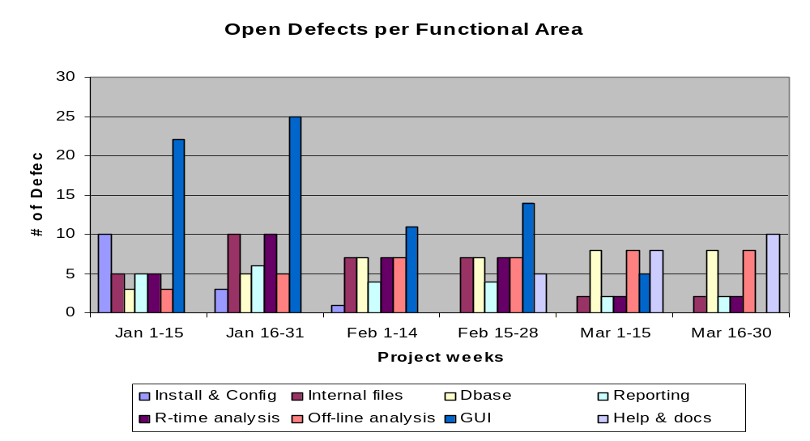
Open Defects per Functional Area
Trending – Pareto (80:20 Rule) Guidance
Notes:
Here is the same Pareto view, but on a time scale and no individual trending. This view is useful to determine component level trending and maturation.

Slide 25
Open Defects per Functional Area
Trending – Pareto (80:20 Rule) Guidance
Partitioning the AUT into meaningful components, then diligently mapping defects to component yields valuable Pareto insights
MAQ
  Different trends within components? Is it expected behavior? (Late vs. early maturation)
  Highest risk, lowest risk areas? By defect count, priority or regression?
  Where to focus process (inspections & unit testing) and testing?
Notes:
Two keys here. First, the team needs to decompose the application into the right set of meaningful components. Too few or too many and you lose management value. If you achieve the “just right” level, then you can target.
Decomposition should be driven (1) architecturally, by reviewing layers and (2) vertically, by functions, features and user scenarios.

Slide 26
Open Defects per Functional Area
Trending – Pareto (80:20 Rule) Guidance
Key Guide Points
  Correct decomposition is the first challenge – horizontally, then vertically
  Requires triage insights into root cause / locale and diligent categorization
  Powerful guiding mechanism
Feedback to PM (and Development, Testing)
  High & Low risk components – testing direction
  Individualized trending and maturation rates
  How component rates map to overall project goals

Slide 27
Wrap-up
Historical Data
Maintain historical data active in your DTS
My observations are that:
  Cycle times repeat (iterations, testing duration)
  Settle times repeat (stabilization for releases of similar composition – new, maintenance, patch)
  Bandwidth capabilities repeat for similarly sized teams and efforts
  Defect injection rates and regression rates repeat for similar efforts
Learn to compare and leverage the patterns

Slide 28
Wrap-up
Theme
If there is a theme to this talk its –
  Look beneath the data
  Be inquisitive - ask questions of yourself and others
  Find the root relationships
  Share your concerns, thoughts, guidance with the broader team
  Take and expect action
In other words, become an Endgame Guide for your team

Slide 29
Thank you for taking the time!
Questions?
Contact Info:
  RGalen Consulting Group, L.L.C.
  PO Box 865, Cary, NC 27512
  919-272-0719
  www.rgalen.com bob@rgalen.com

Slide 30

References
www.stickyminds.com Search for “Metrics Analysis Questions”. Stick Minds article link - http://www.stickyminds.com/getfile.asp?ot=XML&id=5029&fn=Smzr1XDD3368filelistfilename1%2Epdf
Software Endgames: Eliminating Defects, Controlling Change, and the Countdown to On-Time Delivery published by Dorset House in December 2004. www.rgalen.com for order info, misc. related presentations, papers, and link to a Yahoo group focused on Endgames – please join us.
http://www.stpmag.com/issues/stp-2005-03.pdf

